Slide 1


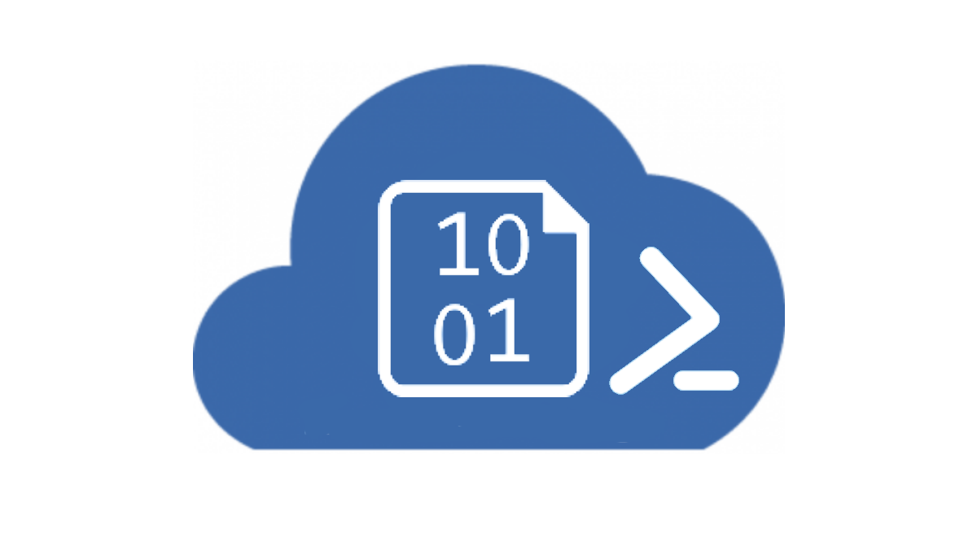


Extracting Session Information
Storing in long term storage such as a file system or Azure Blob Storage.
Extracting to a log store such as Azure Application Insights for Analytics.
Application Insights
Blob Storage
Function App
Monitor Tool
Log Analytics

Slide 2
Extracting Session Information
Application Insights
Blob Storage
Function App
Monitor Tool
Log Analytics

Slide 3
Extracting Session Information
Application Insights
Blob Storage
Function App
Monitor Tool
Log Analytics
Download Monitor Session Details
and Upload to Blob Storage

Slide 4
Extracting Session Information
Application Insights
Blob Storage
Function App
Monitor Tool
Log Analytics
Blob Triggered Function processes Monitor Tool Session Details

Slide 5
Extracting Session Information
Application Insights
Blob Storage
Function App
Monitor Tool
Log Analytics
Function sends individual messages to log store for analysis

Slide 6




Ingesting with the Power Platform
Power BI for visualizations and Analysis
Power Apps for custom User Experiences
Power Automate for Integrations and Delivery
Power Virtual Agent for Assistance and Intelligence

Slide 7
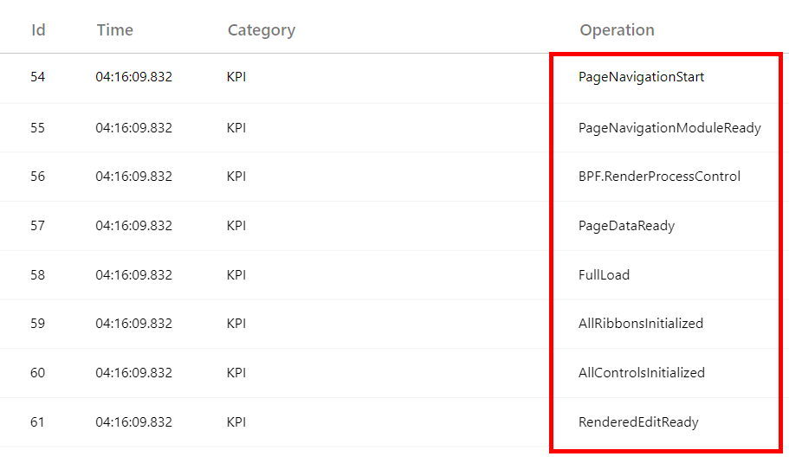
Key Performance Indicators
Key Performance Indicators represent major lifecycle events within a particular user action, such as loading a form.
Provide context into impactful events.
Notes:
Reference: https://community.dynamics.com/crm/b/crminthefield/posts/monitoring-the-power-platform-model-driven-apps---monitor-tool-part-1-messages-and-scenarios
Attribution
On certain Key Performance Indicators a property is included called "Attribution" which represents specific lifecycle events. This includes the commands or actions executed within a KPI. For example, during a form load lifecycle, controls are rendered, ribbon rule are evaluated, onload event handlers are executed, etc. The Attribution property will specify and group, in chronological order, which events happened. An added bonus is the duration is also shown for each event along with if any synchronous calls were made.
Zone Activity and Other Data Points
Within Key Performance Indicators, are other data points that prove useful when debugging performance related issues. Latency and Throughput are shown as well as timings for network related calls and custom script executions. Within the ZoneActivity property we see events grouped by web service calls, browser resource timings and performance observer events. The CustomScriptTime shows the duration of all of the registered event handlers that fired during this particular Key Performance Indicator.

Slide 8
Key Performance Indicators
Key Performance Indicator
Page Navigation Start | the time at which the router initiated the navigation.
Page Navigation Module Ready
BPF Render Process Control
Page Data Ready | fired after the page initialization action has finished retrieving data. This is not necessarily all of the data on the page, since custom controls are free to fetch further data the page is not aware of.
Full Load | the time at which the page load work block ended. Will include all tracked network calls and rendering work finishing.
All Ribbons Initialized | fired after rule evaluation for all ribbons created on the page has been completed.
All Controls Initialized | fired after page data is ready and all controls that have been created on the page have been initialized.
Rendered Edit Ready | fired after onload scripts are called and simple controls are rendered with data. Does not include ribbon or complex control initialization (e.g. subgrids, timeline...).
Notes:
Reference: https://community.dynamics.com/crm/b/crminthefield/posts/monitoring-the-power-platform-model-driven-apps---monitor-tool-part-1-messages-and-scenarios
Attribution
On certain Key Performance Indicators a property is included called "Attribution" which represents specific lifecycle events. This includes the commands or actions executed within a KPI. For example, during a form load lifecycle, controls are rendered, ribbon rule are evaluated, onload event handlers are executed, etc. The Attribution property will specify and group, in chronological order, which events happened. An added bonus is the duration is also shown for each event along with if any synchronous calls were made.
Zone Activity and Other Data Points
Within Key Performance Indicators, are other data points that prove useful when debugging performance related issues. Latency and Throughput are shown as well as timings for network related calls and custom script executions. Within the ZoneActivity property we see events grouped by web service calls, browser resource timings and performance observer events. The CustomScriptTime shows the duration of all of the registered event handlers that fired during this particular Key Performance Indicator.

Slide 9
Key Performance Indicators
Key Performance Indicator | Duration
Page Navigation Start | 26
Page Navigation Module Ready | 93
BPF Render Process Control | 736
Page Data Ready | 1476
Full Load | 10691
All Ribbons Initialized | 10608
All Controls Initialized | 8058
Rendered Edit Ready | 6594
Notes:
Reference: https://community.dynamics.com/crm/b/crminthefield/posts/monitoring-the-power-platform-model-driven-apps---monitor-tool-part-1-messages-and-scenarios
Attribution
On certain Key Performance Indicators a property is included called "Attribution" which represents specific lifecycle events. This includes the commands or actions executed within a KPI. For example, during a form load lifecycle, controls are rendered, ribbon rule are evaluated, onload event handlers are executed, etc. The Attribution property will specify and group, in chronological order, which events happened. An added bonus is the duration is also shown for each event along with if any synchronous calls were made.
Zone Activity and Other Data Points
Within Key Performance Indicators, are other data points that prove useful when debugging performance related issues. Latency and Throughput are shown as well as timings for network related calls and custom script executions. Within the ZoneActivity property we see events grouped by web service calls, browser resource timings and performance observer events. The CustomScriptTime shows the duration of all of the registered event handlers that fired during this particular Key Performance Indicator.

Slide 10
Key Performance Indicators
Key Performance Indicator | Duration
Page Navigation Start | 26
Page Navigation Module Ready | 93
BPF Render Process Control | 736
Page Data Ready | 1476
Full Load | 10691
All Ribbons Initialized | 10608
All Controls Initialized | 8058
Rendered Edit Ready | 6594
Page Navigation Start
Full Load
Page begins to open
Page fully loaded
Page Data Ready
Rendered Edit Ready
All Ribbons Init
Data is Provided
OnLoad Events complete
Ribbon rules eval
Notes:
Reference: https://community.dynamics.com/crm/b/crminthefield/posts/monitoring-the-power-platform-model-driven-apps---monitor-tool-part-1-messages-and-scenarios
Attribution
On certain Key Performance Indicators a property is included called "Attribution" which represents specific lifecycle events. This includes the commands or actions executed within a KPI. For example, during a form load lifecycle, controls are rendered, ribbon rule are evaluated, onload event handlers are executed, etc. The Attribution property will specify and group, in chronological order, which events happened. An added bonus is the duration is also shown for each event along with if any synchronous calls were made.
Zone Activity and Other Data Points
Within Key Performance Indicators, are other data points that prove useful when debugging performance related issues. Latency and Throughput are shown as well as timings for network related calls and custom script executions. Within the ZoneActivity property we see events grouped by web service calls, browser resource timings and performance observer events. The CustomScriptTime shows the duration of all of the registered event handlers that fired during this particular Key Performance Indicator.

